Slide 1
Real Estate Prices in King County 2014 – 2015
Ironhack d.a. bootcamp jan.2022, midterm project
Alejandra Parra, Adriana cuppuleri & Odelia ahdout

Slide 2
Overview
Suggested structure:
Introduce the research/business question you're trying to answer and the type and the objective of the study (descriptive, predictive, BI...);
High-level description of the data you have in hand, supported by meaningful plots/tables (size, quality of the data, how is it distributed, etc.); -- like
Assumptions
Data processing pipeline flowchart; zipcode, bathrooms, age, - preparation: problematic columns,
Insights/Findings:
show only the charts that make sense and have interesting/unusual/meaningful patterns;
every chart/plot need a title and legend;
Describe the features used for the modeling and the algorithms used top 7 features + price transformation, ran a lin reg; + R**2
Outcome & Results (e. g. conclusions, model interpretation, the answer to the research question/hypotheses, etc.);
Outlook (e. g. limitations, next steps, learnings, etc.)

Slide 3
Research question
Which factors are the ones responsible for house prices in King Counry, WA?
The goal of the project is to design a model which would predict selling house-price from a set of features used to evaluate the property.

Slide 4
The database
Feature | Category | Scale/Range | Type (self determined)
ID | General |  | CAT
Date | General |  | CAT
Bedrooms | Distribution of living space | 1 - 11 {33} | CAT
Bathrooms | Distribution of living space | 0.5 - 8 | CAT
Sqft_living | Size |  | #
sqft_lot | Size |  | #
Floors | Distribution of living space | 1 - 3.5 | CAT
Waterfront | Surroundings | 1/0 [Yes/No] | CAT
View | Surroundings | 0-4 | CAT
Condition | Quality Rating | 1-5 | CAT
Grade | Quality Rating | 1-13 | CAT
sqft_above | Size |  | #
sqft_basement | Size |  | #
yr_built | Age | 1900 - 2015 | #
yr_renovated | Renovated? | 0 [No] / 1943 - 2014 | #
zipcode | Location |  | 🌐
lat | Location |  | 🌐
long | Location |  | 🌐
sqft_living15 | Size |  | #
sqft_lot15 | Size |  | #
Price | Dep. Variable |  | #
Consists of information on roughly 22,000 properties in King County, WA, sold between May 2014 and May 2015.
No missing values
No duplicates
Dropped ID, date, longitude & latitude columns

Slide 5
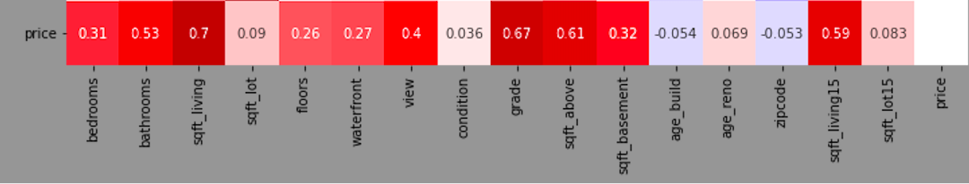
Initial assumptions
Preliminary correlation matrix:
Basic assumptions:
Based on correlations: most influential features are size and grade <=> positively correlated with price
Based on general knowledge: location is important! <=> zipcode should be correlated with price

Slide 6
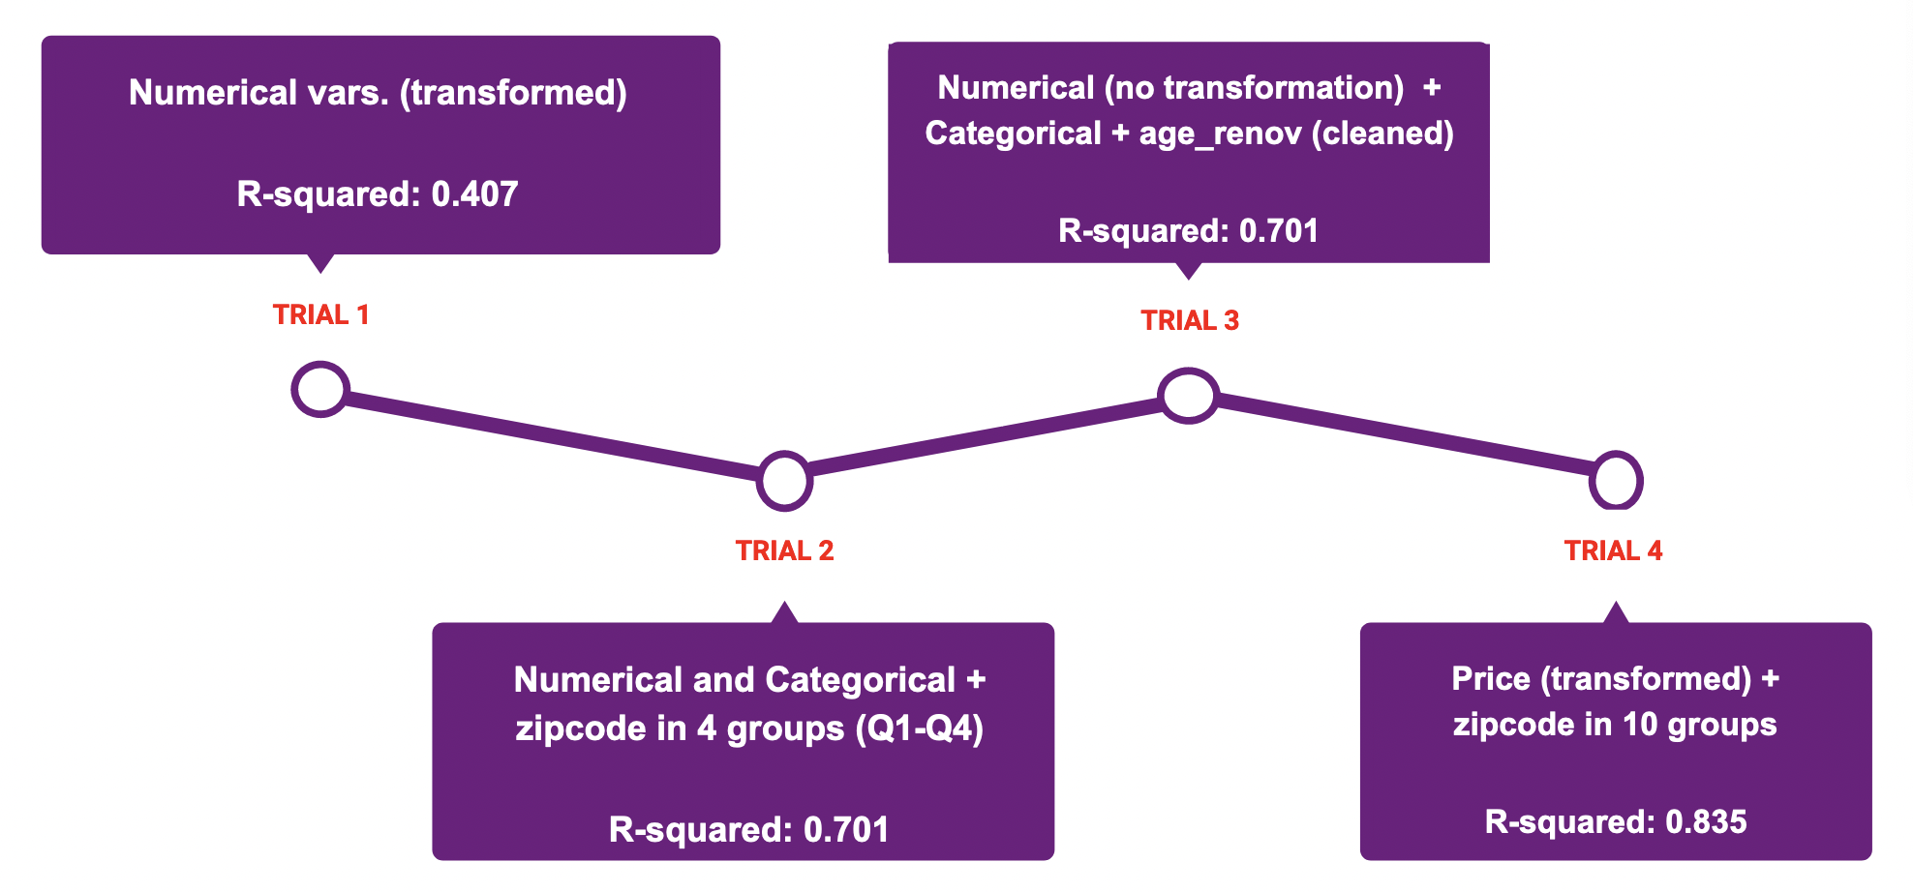
Data processing pipeline

Slide 7
Selected features – trial 4
Feature | Category | Scale/Range | Type (self determined)
ID | General |  | CAT
Date | General |  | CAT
Bedrooms | Distribution of living space | 1 - 11 {33} | CAT
Bathrooms | Distribution of living space | 0.5 - 8 | CAT
Sqft_living | Size |  | #
sqft_lot | Size |  | #
Floors | Distribution of living space | 1 - 3.5 | CAT
Waterfront | Surroundings | 1/0 [Yes/No] | CAT
View | Surroundings | 0-4 | CAT
Condition | Quality Rating | 1-5 | CAT
Grade | Quality Rating | 1-13 | CAT
sqft_above | Size |  | #
sqft_basement | Size |  | #
Age_build | Age | 1900 - 2015 | #
yr_renovated | Renovated? | 0 [No] / 1943 - 2014 | #
Percentile_zip | Location | 1-10 | CAT
lat | Location |  | 🌐
long | Location |  | 🌐
sqft_living15 | Size |  | #
sqft_lot15 | Size |  | #
Price | Dep. Variable |  | #

Slide 8
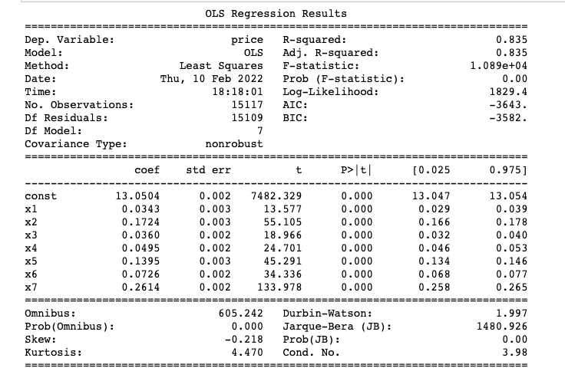
Findings
Trial 4 – linear regression
Feature ranking (based on t):
zipcode 10 ptn > size [sqft_living] > grade > age > view > waterfront > bathrooms

Slide 9
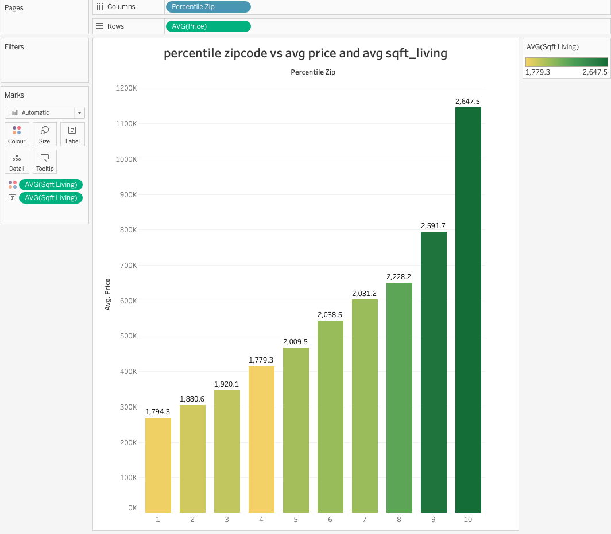
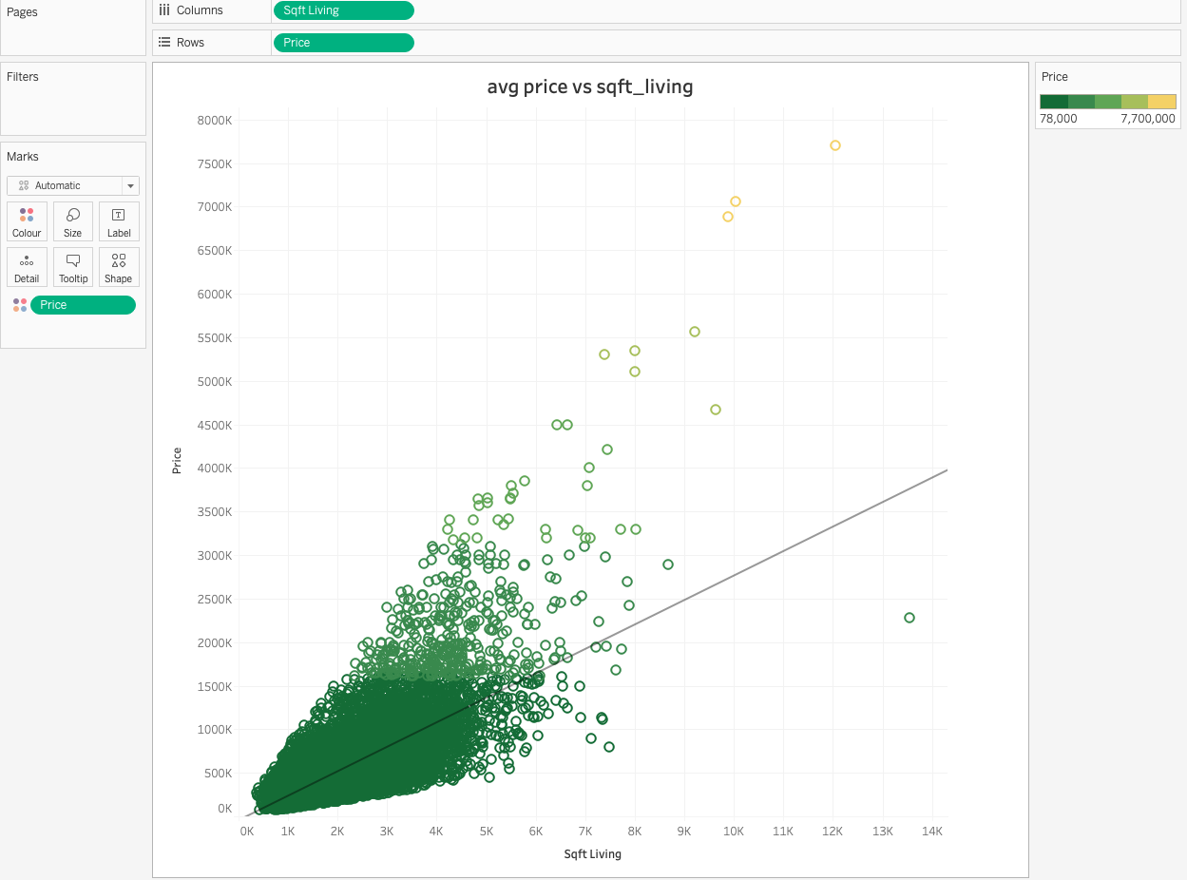
Discussion
Revisiting initial assumptions:
Size in and of itself is not the best predictor of the selling price
Location proved to be the most important feature for predicting the selling house price
Interaction?

Slide 10
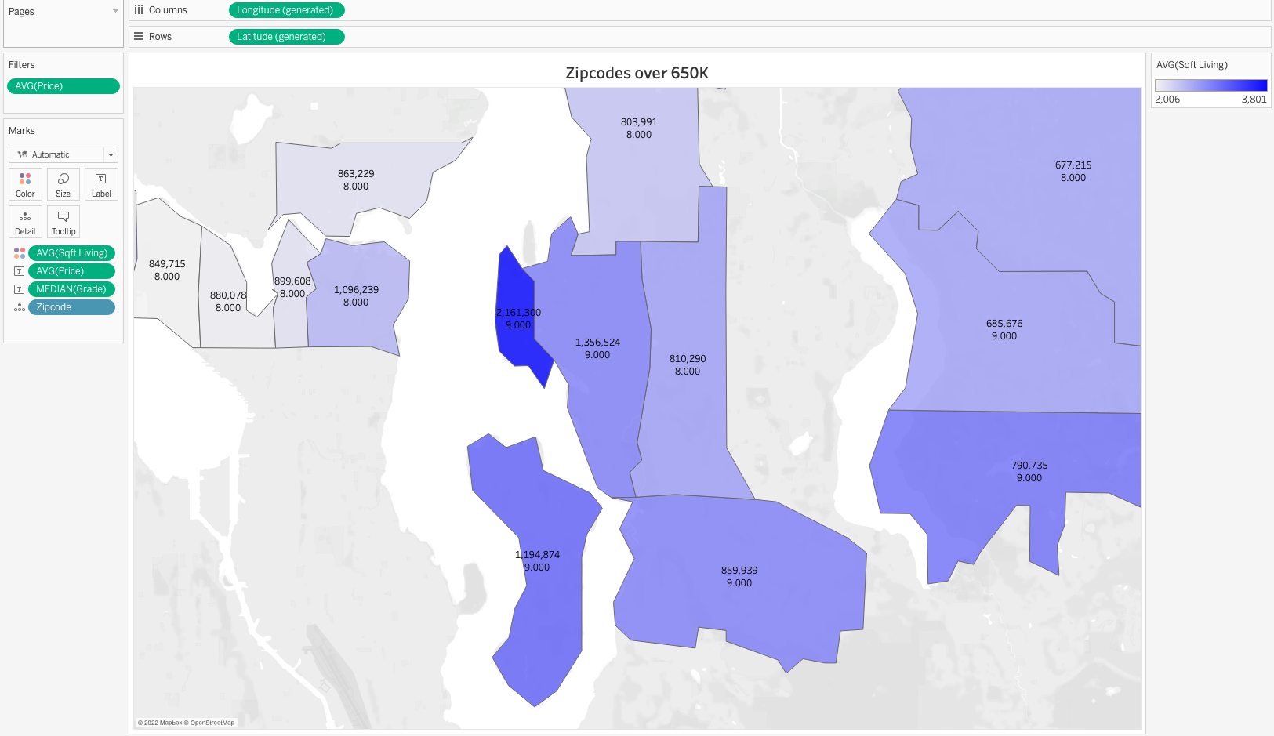
Discussion

Slide 11
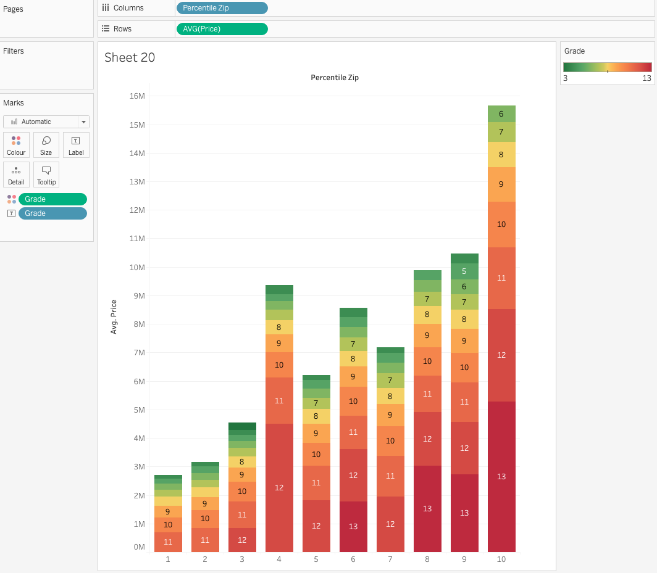
Discussion 3
Highest graded properties tend to be concentrated in one area

Slide 12
Possible improvements
Specific points
Large concentration of highly graded properties in the fourth percentile
General points
Interpreting error metrics is tricky when the dependent variable is transformed
Feature importance – what should one do when the coefficient scales are different?

Slide 13
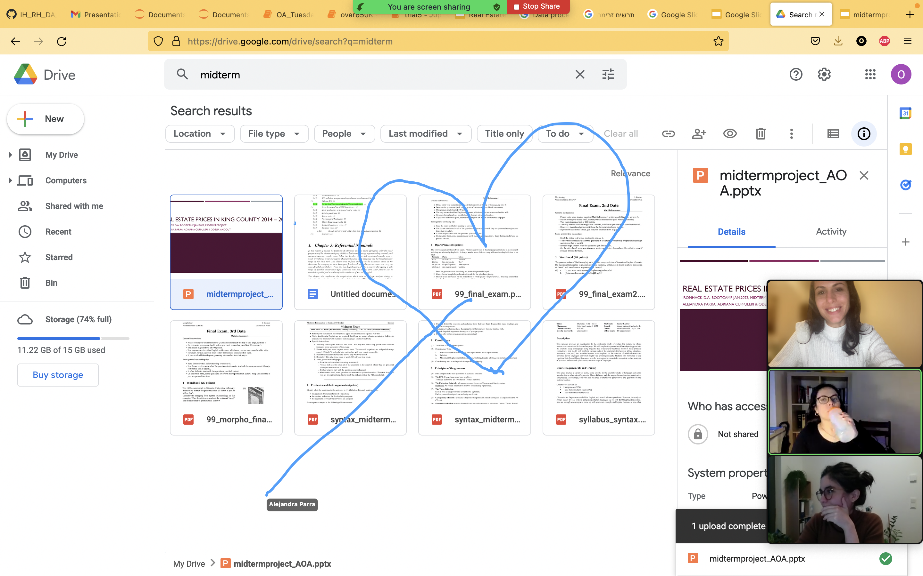
Thanks!
Rafa
Nelson and Kike
Everyone who gave advice, shared insights, and helped deal with Tableau

Slide 14
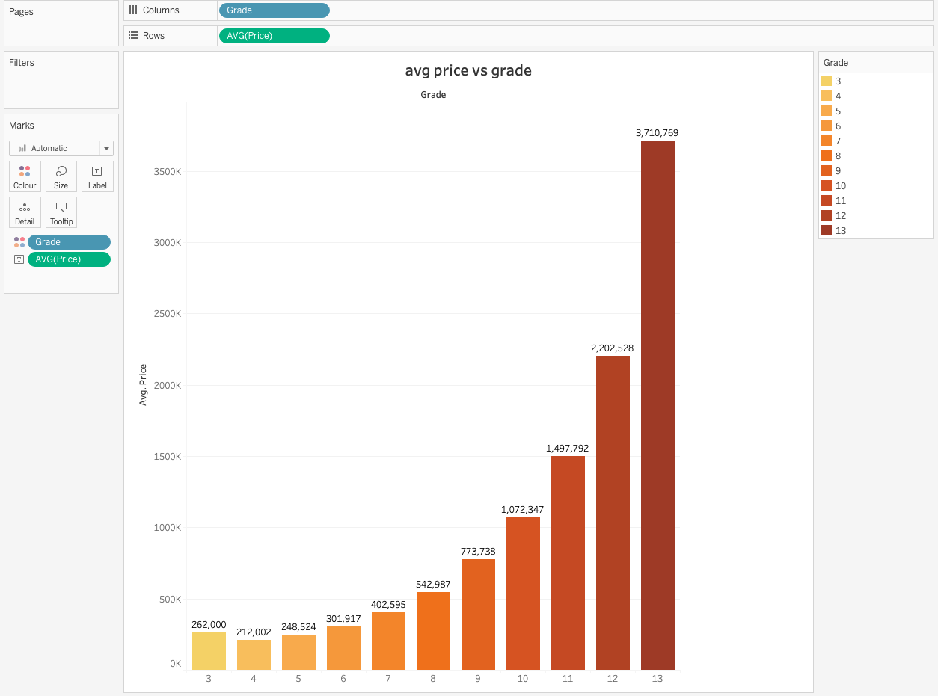

Slide 15
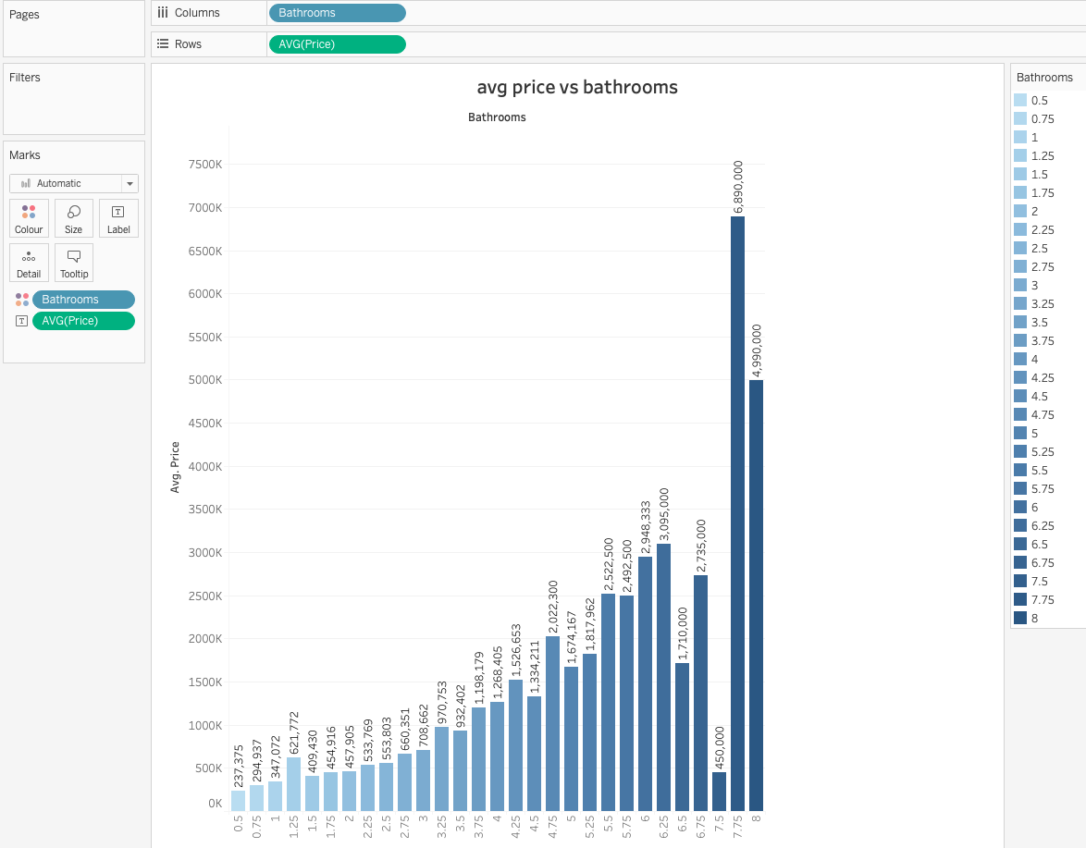

Slide 16
